Slide 1
Chapter 1
Programming Language

Slide 2
Introduction to Programming Language
A programming language is a set of commands, instructions, and other syntax use to create a software program.
are used in computer programming to implement algorithms.
Every programming language has its own syntax (form) and semantics (meaning).
Syntax: set of rules that defines how declarations, functions, commands, and other statements should be arranged in a program.
The first commercially available language was FORTRAN (FORmula TRANslation), developed in 1956 by a team led by John Backus at IBM.
Notes:
Algorithm=finite sequence of well defined instructions

Slide 3
Types of Programming Language
There are two types of programming languages, which can be categorized into the following ways:
1. Low level language
a) Machine language
b) Assembly language
2. High level language
a) Procedural
b) Object Oriented
Notes:
A=1st generation
B=2nd generation
C=3rd generation
D=4th generation

Slide 4
Types of programming language
a) Machine Language
Machine language consists of strings of binary numbers (i.e. 0s and 1s) and it is the only one language, the processor directly understands. Machine language has an Merits of very fast execution speed and efficient use of primary memory.
Merits:
¨ It is directly understood by the processor so has faster execution time since the programs written in this language need not to be translated.
¨ It doesn’t need larger memory.
Demerits:
¨ It is very difficult to program using 1GL since all the instructions are to be represented by 0s and 1s.
¨ Use of this language makes programming time consuming.
¨ It is difficult to find error and to debug.
¨ It can be used by experts only.

Slide 5
Types of programming language
b) Assembly Language
Assembly language is also known as low-level language because to design a program, programmer requires detailed knowledge of hardware specification. This language uses mnemonics code (symbolic operation code like ‘ADD’ for addition) in place of 0s and 1s. The program is converted into machine code by assembler. The resulting program is referred to as an object code.
Merits:
¨ It is makes programming easier than 1GL since it uses mnemonics code for programming. E.g.: ADD for addition, SUB for subtraction, DIV for division, etc.
¨ It makes programming process faster.
¨ Error can be identified much easily compared to 1GL.
¨ It is easier to debug than machine language.
Demerits:
¨ Programs written in this language is not directly understandable by computer so translators should be used.
¨ It is hardware dependent language so programmers are forced to think in terms of computer’s architecture rather than to the problem being solved.
¨ Being machine dependent language, programs written in this language are very less or not portable.
¨ Programmers must know its mnemonics codes to perform any task.

Slide 6
Types of programming language
2. High level language
Instructions of this language closely resembles to human language or English like words.
It uses mathematical notations to perform the task.
The high level language is easier to learn.
It requires less time to write and is easier to maintain the errors.
The high level language is converted into machine language by one of the two different languages translator programs; interpreter or compiler.

Slide 7
Types of programming language
a) Procedural Programming Language
Procedural Programming is a methodology for modeling the problem being solved, by determining the steps and the order of those steps that must be followed in order to reach a desired outcome or specific program state. These languages are designed to express the logic and the procedure of a problem to be solved. It includes languages such as Pascal, COBOL, C, FORTAN, etc.
Merits:
¨ Because of their flexibility, procedural languages are able to solve a variety of problems.
¨ Programmer does not need to think in term of computer architecture which makes them focused on the problem.
¨ Programs written in this language are portable.
Demerits:
¨ It is easier but needs higher processor and larger memory.
¨ It needs to be translated therefore its execution time is more.

Slide 8
Types of programming language
a) Object Oriented Programming Language
Object-oriented programming (OOP) is a computer programming model that organizes software design around data, or objects, rather than functions and logic. An object can be defined as a data field that has unique attributes and behavior.
Merits:
Modularity. Encapsulation enables objects to be self-contained, making troubleshooting and collaborative development easier.
Reusability. Code can be reused through inheritance, meaning a team does not have to write the same code multiple times.
Productivity. Programmers can construct new programs quicker through the use of multiple libraries and reusable code.
Easily upgradable and scalable. Programmers can implement system functionalities independently.
Demerits:
¨ more complicated to write
¨ take more time to compile i.e. it needs more resources

Slide 9
Difference between Procedural and Object Oriented Programming:
Procedural Oriented Programming | Object Oriented Programming
In procedural programming, program is divided into small parts called functions. | In object oriented programming, program is divided into small parts called objects.
Procedural programming follows top down approach. | Object oriented programming follows bottom up approach.
Adding new data and function is not easy. | Adding new data and function is easy.
Procedural programming does not have any proper way for hiding data so it is less secure. | Object oriented programming provides data hiding so it is more secure.
In procedural programming, overloading is not possible. | Overloading is possible in object oriented programming.
In procedural programming, function is more important than data. | In object oriented programming, data is more important than function.
Procedural programming is based on unreal world. | Object oriented programming is based on real world.
Examples: C, FORTRAN, Pascal, Basic etc. | Examples: C++, Java, Python, C# etc.
Notes:
Data hiding is obtained through data abstraction and also encapsulation. Encapsulation is binding methods and data together like a medicine capsule contains herbs.
Overloading is a concept where a single process has multiple alternatives. The payment option on any ecommerce website has several options like netbanking, COD, credit card, etc. That means, a payment method is overloaded several times to perform single payment function in various ways.
Overloading is a function related to polymorphism in OOP. A single task is performed in many ways.

Slide 10
Language Processor
A language processor is a special type of computer software that can translate the source code of a program to machine code.
Source code written in high level language needs to be converted into machine code before it can be executed. Therefore we need language processor.
The following are the different types of language processor
Assembler
Interpreter
Compiler

Slide 11
Assembler
The Assembler is used to translate the program written in Assembly language into machine code.
The source program is a input of assembler that contains assembly language instructions. The output generated by assembler is the object code or machine code understandable by the computer.

Slide 12
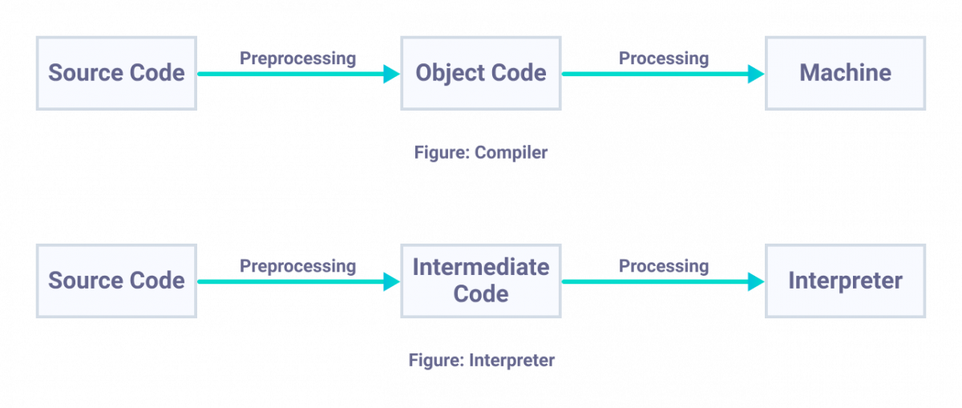
Interpreter
The translation of single statement of source program into machine code is done by language processor and executes it immediately before moving on to the next line is called an interpreter.
If there is an error in the statement, the interpreter terminates its translating process at that statement and displays an error message.
The interpreter moves on to the next line for execution only after removal of the error.
An Interpreter directly executes instructions written in a programming or scripting language without previously converting them to an object code or machine code. Example: Perl, Python and Matlab.
Notes:
Pre processing generally occurs to remove the comments and other documentation details from the code and only the relevant statements are then interpreted.

Slide 13
Compiler
The language processor that reads the complete source program written in high level language and translates it in machine language is called as a Compiler.
In a compiler, the source code is translated to object code successfully if it is free of errors. The compiler specifies the errors at the end of compilation with line numbers when there are any errors in the source code.

Slide 14
Difference between Compiler and Interpreter –
COMPILER | INTERPRETER
A compiler is a program which coverts the entire source code of a programming language into executable machine code for a CPU. | interpreter takes a source program and runs it line by line, translating each line as it comes to it.
Compiler takes large amount of time to analyze the entire source code but the overall execution time of the program is comparatively faster. | Interpreter takes less amount of time to analyze the source code but the overall execution time of the program is slower.
Compiler generates the error message only after scanning the whole program, so debugging is comparatively hard as the error can be present any where in the program. | Its Debugging is easier as it continues translating the program until the error is met
Generates intermediate object code. | No intermediate object code is generated.
Examples: C, C++, Java | Examples: Python, Perl

Slide 15
Errors in program
In computer programming, an error or bug is an action which is inaccurate or incorrect.
There are three basic type of programming errors:
syntax errors
logic errors
runtime errors

Slide 16
Syntax error
Error that occurs if the syntax of the programming language is not followed correctly.
With compiled languages, you will run into any syntax errors at compile time, and they will have to be corrected before the program can run. For interpreted languages, a syntax error would pop up during run time, and your error message might not even specify it’s a syntax problem.
In both cases, the compiler/interpreter will give you the location of the syntax error, which makes it rather easy to find/fix.
Many text editors or IDEs will come with the ability to warn you about syntax errors at the time of writing the code
Some of the examples of syntax error can be
Missing statement terminator (;)
Missing operators (e.g. 2/+5)
Unbalanced braces ({})
Using keyword as an identifier (main = 25)

Slide 17
Logic error
Logic errors occurs when a programmer implements the algorithm for solving a program incorrectly
Logical error are hardest to track down. A logic error produces unintended or undesired output or other behavior.
Compiler cannot detect the logical error
Multiplying two numbers instead of addition
Using wrong values while computing
missing or misplaced braces will probably not be detected by the compiler but can cause many different logical errors.
function average(a,b) {
return a+b/2;
}
if (a == b);
print “Yes”;

Slide 18
Runtime errors
A runtime error is a program error that occurs while the program is running.
Runtime error are fatal and causes the program to terminate immediately without finishing its job.
A program crash is the most noticeable type of runtime error, since the program unexpectedly quits while running.
Crashes can be caused by memory leaks or other programming errors. Common examples include dividing by zero, referencing missing files, calling invalid functions, or not handling certain input correctly.

Slide 19
Features of a good program
A computer program is a collection of instructions that can be executed by a computer to perform a specific task.
Portability:
Portability refers to the ability of an application to run on different platforms (operating systems) with or without minimal changes.
Program developed for a particular platform has a short life span.
Readability:
The program should be written in such a way that it makes other programmers or users to follow the logic of the program without much effort.
If a program is written structurally, it helps the programmers to understand their own program in a better way. Even if some computational efficiency needs to be sacrificed for better readability, it is advisable to use a more user-friendly approach, unless the processing of an application is of utmost importance.
Efficiency:
Every program requires certain processing time and memory to process the instructions and data.
A program is said to be efficient if it uses less amount of resources during execution.
Notes:
Readability means how easy the computer program is to understand. ... Any program that ends up to production should ultimately be readable. Readable programs are more valuable than their unreadable counterparts because: They require less maintenance.

Slide 20
Features of a good program contd…
Structural:
To develop a program, the task must be broken down into a number of subtasks. These subtasks are developed independently, and each subtask is able to perform the assigned job without the help of any other subtask.
If a program is developed structurally, it becomes more readable, and the testing and documentation process also gets easier.
Flexibility:
A program should be flexible enough to handle most of the changes without having to rewrite the entire program.
Most of the programs are developed for a certain period and they require modifications from time to time.
Generality:
Apart from flexibility, the program should also be general. Generality means that if a program is developed for a particular task, then it should also be used for all similar tasks of the same domain.
For example, if a program is developed for a particular organization, then it should suit all the other similar organizations.
Documentation:
Documentation is one of the most important components of an application development. Even if a program is developed following the best programming practices, it will be rendered useless if the end user is not able to fully utilize the functionality of the application.
A well-documented application is also useful for other programmers because even in the absence of the author, they can understand it.
Notes:
The documentation either explains how the software operates or how to use it, and may mean different things to people in different roles.

Slide 21
Programming paradigm
A programming paradigm is a style, or “way,” of programming.
Programming paradigms reduce the complexity of programs. Every programmer must follow a paradigm approach when implementing their code. Each one has its advantages and disadvantages.
It helps us to classify the programming languages based on their features.
Types of programming paradigm
Imperative programming paradigm
Procedural programming paradigm
Object oriented programming
Parallel processing approach
Declarative programming paradigm
Logic programming paradigm
Functional programming
Database processing approach

Slide 22
1. Imperative programming paradigm
Instruction are given to computer for the step by step execution of the program
The order of the steps is crucial, because a given step will have different consequences depending on the current values of variables when the step is executed. For e.g. lets see a program in C
#include <stdio.h>
int main() {
int sum = 0;
sum += 1;
sum += 2;
sum += 3;
sum += 4;
sum += 5;
printf("The sum is: %d\n", sum);
return 0;
}

Slide 23
1.1 Procedural programming paradigm
The procedural programming paradigm is where program code is divided up into procedures, discrete blocks of code that carry out a single task.
Procedures, also known as routines, subroutines, or functions, simply contain a series of computational steps to be carried out in the order specified by the programmer.
Advantage
It is much easier to test and debug,
Subroutines can be called many times, reducing the amount of repeated code.
Subroutines can manipulate shared data.
Subroutines can be saved in libraries and imported into programs when they are needed. This means that code is reusable; it's good if you can write code once and make use of it many times.
Disadvantage
Not good for developing large applications
software developed in procedural programming is not flexible i.e. it cannot accept changing requirements easily
The data is exposed to the whole program, making it not so much security friendly
Difficult to relate with real world objects

Slide 24
1.2 Object oriented programming
OOP is the most popular programming paradigm because of its unique advantages like the modularity of the code and the ability to directly associate real-world business problems in terms of code.
Object Oriented Programming (OOP) is a paradigm in which real-world objects are each viewed as separate entities having their own state which is modified only by built in procedures, called methods.
Objects are organized into classes, from which they inherit methods and equivalent variables.
Programming languages that have implemented the OO paradigm are: Ruby, Java, C++, Python, Simula (the first OOP language)
Advantage
Reusability
Flexibility
Secure

Slide 25
Procedural Programming | Object Oriented Programming
It is less secure than OOPs. | Data hiding is possible so, it is more secure than procedural programming.
It follows a top-down approach. | It follows a bottom up approach.
In procedural programming, data moves freely within the system from one function to another. | In OOP, objects can move and communicate with each other via member functions
Overloading is not possible in procedural programming. | In OOP, there is a concept of function overloading and operator overloading
It gives importance to functions over data. | It gives importance to data over functions
It is not appropriate for complex problems. | Appropriate for complex problems.
In Procedural programming, a program is divided into small programs that are referred to as functions. | In OOP, a program is divided into small parts that are referred to as objects.
Examples of Procedural programming include C, Fortran, Pascal, and VB. | The examples of object-oriented programming are - .C#, Python, Java, C++.

Slide 26
1.3 Parallel processing approach
Parallel processing is the processing of program instructions by dividing them among multiple processors.
A parallel processing system allows many processors to run a program in less time by dividing them up.
Languages that support the Parallel processing approach:
C
C++
Best suited when our computer system has more than one CPU or multicore
Good for problems which require more computation.

Slide 27
2. Declarative programming paradigm
Declarative programming is a programming paradigm in which the programmer defines what needs to be accomplished by the program without defining how it needs to be implemented. In other words, the approach focuses on what needs to be achieved instead of instructing how to achieve it.

Slide 28
2.1 logic programming paradigm
The Logical Paradigm takes a declarative approach to problem-solving. It is based on logic and control. Logic means fact and rules whereas control means order of the rules.
The logic defines what is to be solved and control defines how to solve it.
Main advantage of logic program is that the programmer simply needs to define what part of the problem and the system finds the best solution to that problem.
Best suited for projects like theorem proving, expert system, automated planning.
For e.g. PROLOG
Advantage
Easy to implement the code.
Debugging is easy.
Since it's structured using true/false statements, we can develop the programs quickly using logic programming.

Slide 29
2.2 Functional programming paradigm
Functional programming is just programming with functions—pure mathematical functions.
Programs are built by combining functions together.
You compose your program of short functions. All code is within a function. All variables are scoped to the function.
In functional programming, the program written in programming language will always product output exactly similar to its equivalent mathematical function.
Immutability is one of the important features of functional programming. The variable value will remain the same for the life span of the variable.
Programming Languages that support functional programming: Haskell, JavaScript, Python, Scala, Lisp.
Applications:
It is used in mathematical computations.
It is needed where concurrency or parallelism is required.
Notes:
https://opensource.com/article/17/4/introduction-functional-programming
A pure function is a function which:
Given the same input, will always return the same output.
Produces no side effects.
It is used to implementt concurrency/parallelism because pure functions don’t change variables or any other data outside of it.
Immutability=value can’t be changed and remains the same throughout the program

Slide 30
Software development model
Software development model is a development strategy that encompasses the process, methods, and tools that are adapted while developing a software.
A software development model is chosen based on the nature of the project, the methods and tools to be used, and the deliverables that are required.
There are various types of software development models as mentioned below:
Notes:
A deliverable could be a report, a document, a software product, a server upgrade or any other building block of a project.

Slide 31
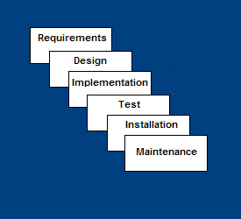
Waterfall Model
Requirements – defines needed information, function, behavior, performance and interfaces.
Design – data structures, software architecture, interface representations, algorithmic details.
Implementation – source code, database, user documentation, testing.

Slide 32
Waterfall Strengths
This model is simple and easy to understand and use.
It is easy to manage due to the rigidity of the model – each phase has specific deliverables and a review process.
In this model phases are processed and completed one at a time. Phases do not overlap.
Waterfall model works well for smaller projects where requirements are clearly defined and very well understood.

Slide 33
Waterfall Deficiencies
All requirements must be known upfront
Once an application is in the testing stage, it is very difficult to go back and change something that was not well-thought out in the concept stage.
Real projects rarely follow the sequential flow since they are always iterative.
Integration is one big bang at the end
No working software is produced until late during the life cycle.

Slide 34
When to use the Waterfall Model
Requirements are very well known
Product definition is stable
Technology is understood
New version of an existing product
Porting an existing product to a new platform.

Slide 35
Prototyping Model
Developers build a prototype during the requirements phase
Prototype is evaluated by end users
Users give corrective feedback
Developers further refine the prototype
When the user is satisfied, the prototype code is brought up to the standards needed for a final product.

Slide 36
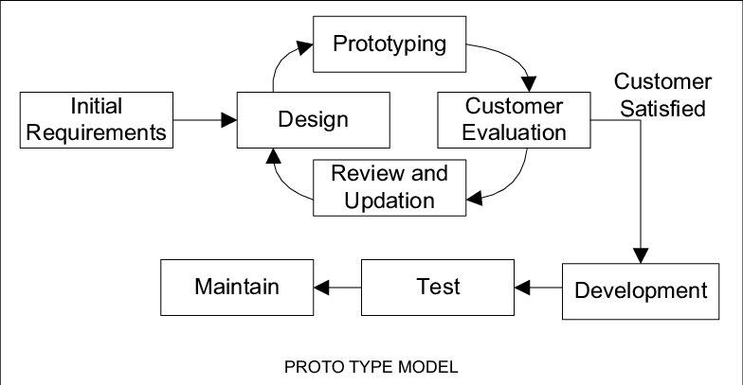
Prototype model

Slide 37
Prototyping model Strengths
Since in this methodology a working model of the system is provided, the users get a better understanding of the system being developed.
Developers learn from customers
A more accurate end product can be produced since errors can be detected much earlier
Missing functionality can be identified easily
Quicker user feedback is available leading to better solutions.
Interaction with the prototype stimulates awareness of additional needed functionality

Slide 38
Prototyping model Weaknesses
Overall maintainability may be overlooked
The customer may want the prototype delivered.
Process may continue forever

Slide 39
When to use prototype model
Requirements are unstable or have to be clarified
As the requirements clarification stage of a waterfall model
Develop user interfaces
Short-lived demonstrations

Slide 40
Rapid application development (RAD) model
It is an incremental software development model that emphasizes an extremely short development cycle.
it is high speed adaptation of waterfall model in which rapid application development is achieved using component based construction.
Enables development team to create a “fully functional system” within a short period of time e.g. 60 – 90 days

Slide 41
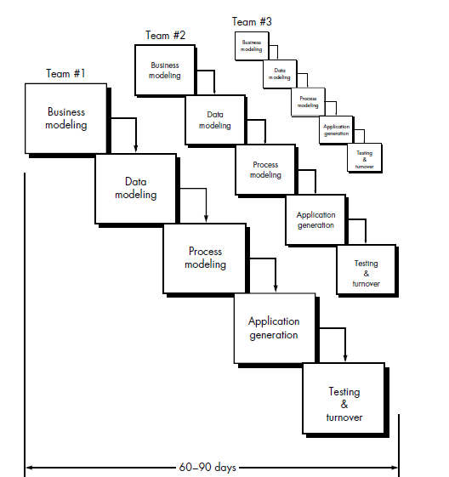
RAD model

Slide 42
RAD Strengths
Reduced cycle time and improved productivity with fewer people means lower costs
Time-box approach mitigates cost and schedule risk
Customer involved throughout the complete cycle minimizes risk of not achieving customer satisfaction and business needs
Uses modeling concepts to capture information about business, data, and processes.

Slide 43
RAD Weaknesses
Not appropriate when technical risk is high
Accelerated development process must give quick responses to the user
Not appropriate if the system can’t be modularized
Requires commitment from both developers and customers for rapid fire completion of activities
Not suitable for large projects since it requires sufficient human resource to create right number of RAD teams

Slide 44
When to use RAD
Reasonably well-known requirements
User involved throughout the life cycle
Project can be time-boxed
Functionality delivered in increments
High performance not required
Low technical risks
System can be modularized

Slide 45
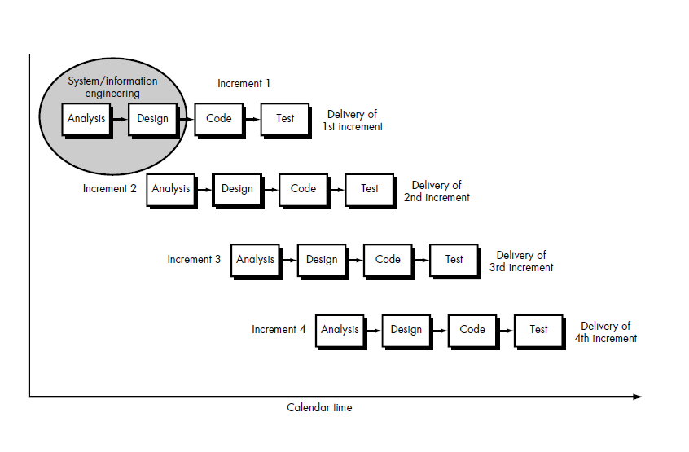
Incremental SDLC Model
Is an evolutionary model of SDLC
First increment is often a core product (basic requirements are addressed)
Construct a partial implementation of a total system
Then slowly add increased functionality
The incremental model prioritizes requirements of the system and then implements them in groups.
Each subsequent release of the system adds function to the previous release, until all designed functionality has been implemented.

Slide 46
Incremental Model Strengths
Develop high-risk or major functions first
Each release delivers an operational product
Customer can respond to each build
Uses “divide and conquer” breakdown of tasks
Lowers initial delivery cost
Initial product delivery is faster
Customers get important functionality early
Risk of changing requirements is reduced

Slide 47
Incremental Model Weaknesses
Requires good planning and design
Requires early definition of a complete and fully functional system to allow for the definition of increments
Total cost of the complete system is not lower

Slide 48
When to use the Incremental Model
Most of the requirements are known up-front but are expected to evolve over time
A need to get basic functionality to the market early
On projects which have lengthy development schedules
On a project with new technology

Slide 49
Spiral model
An evolutionary model which combines the best feature of the classical life cycle with and the iterative nature of prototype model
Each phase of spiral model begins with design goal and ends with client review
Software is developed in a series of incremental releases

Slide 50
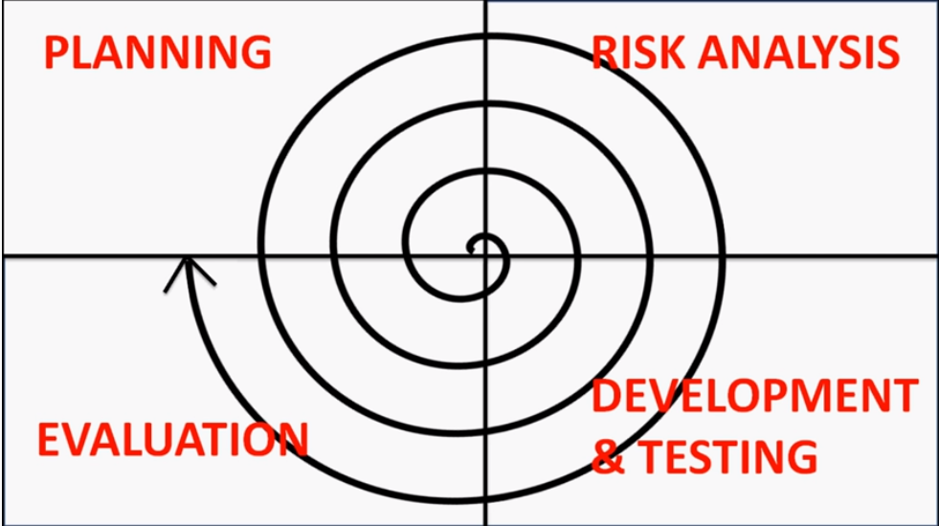
Spiral model contd…
Each phase of Spiral Model is divided into four quadrants:
Determine objective (planning)
Requirements will be gathered
Alternative solutions are proposed for next phase
Identify and resolve risk (risk analysis)
Possible risk will be identified and resolved. Prototype will be developed for the best solution proposed at the end of this quadrant
Development and test
Identified features are developed and verified through testing
Plan next iteration (evaluation)
Output is evaluated before next spiral starts and at the end next iteration is planned

Slide 51
advantages of the Spiral SDLC Model
Changing requirements can be accommodated.
Allows extensive use of prototypes.
Requirements can be captured more accurately.
Users see the system early.
Development can be divided into smaller parts and the risky parts can be developed earlier which helps in better risk management.

Slide 52
disadvantage of spiral SDLC model
Management is more complex.
End of the project may not be known early.
Not suitable for small or low risk projects and could be expensive for small projects.
Spiral model is complex compared to other SDLC model
Spiral may go on indefinitely.
Large number of intermediate stages requires excessive documentation.

Slide 53
When to use Spiral Model
When creation of a prototype is appropriate
When costs and risk evaluation is important
For medium to high-risk projects
Users are unsure of their needs
Requirements are complex
New product line
Significant changes are expected (research and exploration)

Slide 54
Agile model
The term “agile” means “the ability of responding to changes”
It is an iterative and incremental process
Direct collaboration with the customers
Each iteration lasts from one to three weeks
Each build is incremental in terms of features
Final build holds all the requirements by the customer

Slide 55
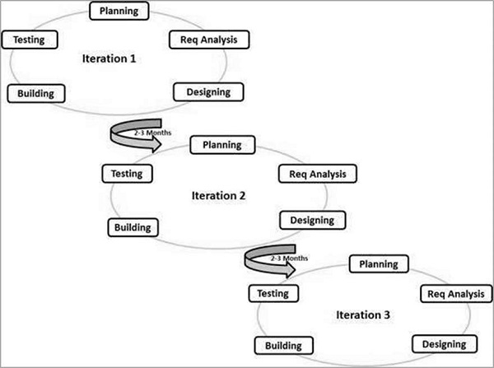
Agile model contd…

Slide 56
advantages of the Agile Model
Is a very realistic approach to software development.
Promotes teamwork
Functionality can be developed rapidly and demonstrated.
Resource requirements are minimum.
Suitable for fixed or changing requirements
Delivers early partial working solutions.
Easy to manage.
Welcome changing requirements even late in development

Slide 57
Disadvantage of agile model
Less predictability
More time and commitment
Greater demands on developers and clients
Lack of necessary documentation
Project easily falls off track

Slide 58
When to avoid agile
This method is not beneficial when the client must work on a specified budget or schedule.
You should also avoid it when clients cannot change the scope of the project once it starts.

Slide 59
Program development life cycle
The program development life cycle is a tool used to guide the computer programmers throughout the development of an application.
Generally, the program development life cycle contains 6 phases, they are as follows….
Problem Definition
Problem Analysis
Algorithm Development
Coding & Documentation
Testing & Debugging
Maintenance

Slide 60
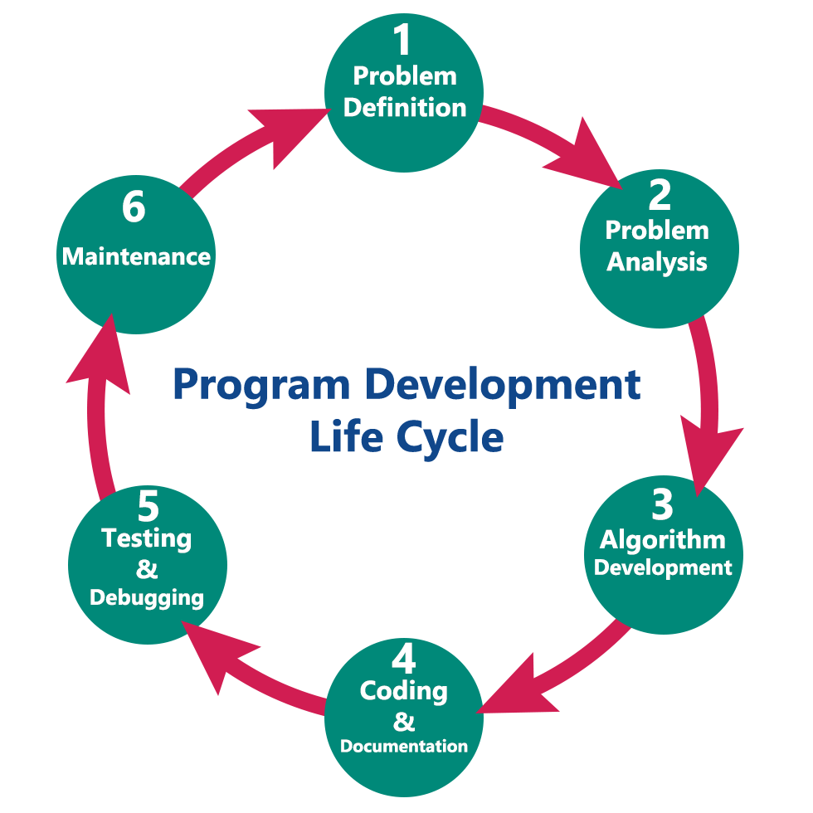
Program development life cycle contd…

Slide 61
Program development life cycle contd…
Problem definition
Precisely define the problem to be solved
List out the requirements of the system
Problem analysis
Issues are diagnosed along with the way to fix them with proper solution
Program input, processing, output required to solve the problem is identified
Algorithm development
Step by step procedure is developed to solve the problem using the specification given in the previous phase.
Tool like pseudocode, flowchart can be used to develop the algorithm of the problem statement.
Coding and documentation
A programming language is used to develop the solution of the problem as per the algorithm developed in the previous stage
Actual implementation of the program is done in this stage.
Documentation is done along with the coding by including comments and remarks within the code to explain the purpose of the code statements.
Testing and debugging
In this stage we test the developed program to see if it gives us the desired output or not.
If any errors are found in the program then correction is also done in this phase.
Maintenance
In this phase the developed program is used by the end user.
Unanticipated errors are corrected in this stage
If the user requires any enhancement then it all the above steps are repeated.

Slide 62
System design tools
System design tools are shapes, symbols, tables which represent flow of system, components of system, conditions and action to be taken while implementing into the code.
System design tools are used in the design phase of SDLC which helps human-readable requirements to be transformed into actual code.
Some of the system design tools used by the software developers are:
Data flow diagram(DFD)
Pseudo-code
Decision tables
E-R (entity relationship) diagram
Notes:
Flow chart might also be included.

Slide 63

Data flow diagram (DFD)
A DFD is a graphical representation of the flow of data from one component to another in an information system.
It is capable of depicting incoming data flow, outgoing data flow and stored data.
DFD can represent Source, destination, storage and flow of data using the following set of components -

Slide 64
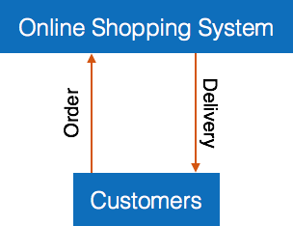
DFD components
Entities - Entities are source and destination of information data. Entities are represented by a rectangles with their respective names.
Process - Activities and action taken on the data are represented by Circle or Round-edged rectangles.
Data Storage - There are two variants of data storage - it can either be represented as a rectangle with absence of both smaller sides or as an open-sided rectangle with only one side missing.
Data Flow - Movement of data is shown by pointed arrows. Data movement is shown from the base of arrow as its source towards head of the arrow as destination.
Figure: context diagram (Level 0 DFD)
Notes:
CONTEXt diagram gives a general overview of the system. It doesn’t show process and so on in the middle.

Slide 65
Pseudo-code
Pseudo-code is written more close to programming language.
Pseudo-code contains more programming details than structured English.
Example of a pseudo-code to add two numbers
BEGIN
NUMBER s1, s2, sum
OUTPUT("Input number1:")
INPUT s1
OUTPUT("Input number2:")
INPUT s2
sum=s1+s2
OUTPUT sum
END
Notes:
Pseudo=false

Slide 66
Decision table
A decision table is an excellent tool to use in both testing and requirements management.
It is a structured exercise to formulate requirements when dealing with complex business rules.
Decision tables are used to model complicated logic.
Help test all combinations of conditions
To create the decision table, the developer must follow basic four steps:
Identify all possible conditions to be addressed
Determine actions for all identified conditions
Create Maximum possible rules
Define action for each rule

Slide 67
Decision table example
Conditions | Rule 1 | Rule 2 | Rule 3 | Rule 4
Username (T/F) | F | T | F | T
Password (T/F) | F | F | T | T
Output (E/H) | E | E | E | H
Table showing decision table of a login screen.
Legend:
T – Correct username/password
F – Wrong username/password
E – Error message is displayed
H – Home screen is displayed

Slide 68
Entity Relationship (ER) Diagram
An Entity Relationship (ER) Diagram is a type of flowchart that illustrates how “entities” such as people, objects or concepts relate to each other within a system.
It is a logical structure of a database that can be expressed graphically.
ER diagrams use a defined set of symbols such as rectangles, diamonds, ovals and connecting lines to depict the interconnectedness of entities, relationships and their attributes.

Slide 69
ER diagram
Entity:
A definite thing—such as a person, object, concept or event—that can have data stored about it. Think of entities as nouns. Examples: a customer, student, car or product. Typically shown as a rectangle.
Attribute:
A property or characteristic of an entity. Often shown as an oval or circle.
For example: student_name, student_address, student_email etc.
Relationship:
How entities act upon each other or are associated with each other. Think of relationships as verbs. For example, the named student might register for a course.
It represented by diamond
Lines:
The flow of information is indicated by the lines in RE Diagram.
It is represented by a line.

Slide 70
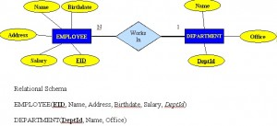
ER diagram
Notes:
The above example shows a many to one relationship.
Dep Id goes to employee table as a primary key. Isn’t possible the other way.
Primary key is underlined.

Slide 71
E-R Diagram
M
M
Enrolls in
student
course
1
Stu_course
Notes:
M=many
1=one
So many to one relationship
Or one to many relationship
If there are many to many relationships, then a new table should be created such that one to many relationships are created.

